Slide 1
A Block Chain based Management System for Detecting Counterfeit Product in Supply Chain
Project Guide: AMINA FIDHA
JIBIN THOMAS TCR19MCA002

Slide 2
INTRODUCTION
In recent years, Counterfeit goods play a vital role in product manufacturing industries. This Phenomenon affects the sales and profit of the companies.
To ensure the identification of real products throughout the supply chain, a functional block chain technology used for preventing product counterfeiting.
By using a block chain technology, consumers do not need to rely on the trusted third parties to know the source of the purchased product safely.
In view of the fact that a block chain is the decentralized, distributed and digital ledger that stores transactional records known as blocks of the public in several databases known as chain across many networks. Therefore, any involved block cannot be changed in advance, without changing all subsequent block.

Slide 3
EXISTING SYSTEM
Nowadays, counterfeit products are growing exponentially in online and black-market. The black market is a biggest challenge in supply chain.
The government has introduced several laws and regulations against fake products even though the government cannot control counterfeit products.
Therefore, there is a need of an approach for detecting counterfeit products and providing security techniques to alert both manufacturer and consumer in supply chain.

Slide 4
PROPOSED SOLUTION
We proposed block chain based management system activates the consumer and enterprise vendor to track and identify the real product using a Smartphone.
Counterfeit products are detected using barcode reader, where a barcode of the product linked to a Block Chain Based Management (BCBM) system.
So the proposed system may be used to store product details and unique code of that product as blocks in database.
It collects the unique code from the customer and compares the code against entries in block chain database. If the code matches, it will give notification to the customer, otherwise it gets information from the customer about where they bought the product to detect counterfeit product manufacturer.

Slide 5
OBJECTIVE
A Block Chain based Management System for Detecting Counterfeit Product in Supply Chain

Slide 6
REQUIREMENT SPECIFICATIONS
SOFTWARE REQUIREMENTS :
Operating System : Windows 8 /10for Better Performance
Front End : Python (Flask)
Back End : Mysql
Software Used : Pycharm
Web Browser : Internet-Explorer/Google Chrome/Firefox(for web application)

Slide 7
HARDWARE REQUIREMENTS
Input Device : Mouse, Keyboard
Output Device : Monitor
Memory : 4 Gb Ram(Minimum)
Processor : Intel core i3 or above

Slide 8
BASIC FUNCTIONALITIES
Manufacturer
Manufacturer generates an encrypted QR code which cannot be reused by the manufacturer for different product and attaches the transaction to the block chain-based management system.

Slide 9
QR(Quick Response) Code
A barcode is a label that contains information about the item to which is attached. QR codes are using as an anti-counterfeiting element to help consumer to identify whether the product is real or fake.

Slide 10
User Authentication
The QR code consist the details of product which is manufactured by manufacturer. The transaction between manufacturer and consumer is secure and tempered-resistant. Each transaction of block in block chain will contain a unique QR code, which cannot be reused by the manufacturer for different product. If the user wants to check their product, scan QR code of the product, it collects the unique code from the customer and compares the code against entries in block chain database. If the code matches, it will give notification to the customer, otherwise it gets information from the customer about where they bought the product to detect counterfeit product manufacturer.

Slide 11
FUNCTIONAL REQUIREMENTS
This section specifies all the fundamental action of the software system.
Class 1: MANUFACTURER
Functional requirements 1.1
Title :Product Management
Description: Manufacturer can add /view/delete Products

Slide 12
Class 2: CUSTOMER
Functional requirements 1.1
Title :Scan QR
Description: Customer can scan QR code
Functional requirements 1.2
Title :View product
Description: Customer can view products

Slide 13
Functional requirements 1.3
Title :Detect
Description: To detect counterfeit product
NON FUNCTIONAL REQUIREMENTS
Error handling
Performance Requirements

Slide 14
Safety Requirements
Security Requirements
System will use secured database.
The system shall permit only administrator/owner to modify the contents

Slide 15
MODULES
Manufacturer
Registration
Login
Product Management

Slide 16
Customer
Registration
Login
Scan QR
View Product
Detect

Slide 17
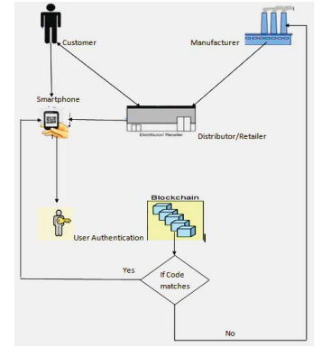
SYSTEM ARCHITECTURE

Slide 18
BLOCK DIAGRAM
SCAN QR CODE
USER REGISTER
LOGIN
GIVE NOTIFICATION/ GET INFORMATION BASED ON THE PRODUCT
CONTAINS PRODUCT DETAILS AND UNIQUE CODE
CHECK UNIQUE CODE
SEND TO CUSTOMER
END

Slide 19
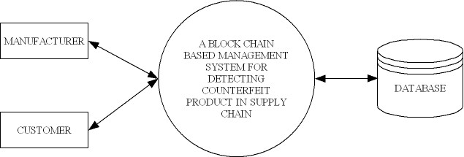
DATA FLOW DIAGRAM
Level 0

Slide 20
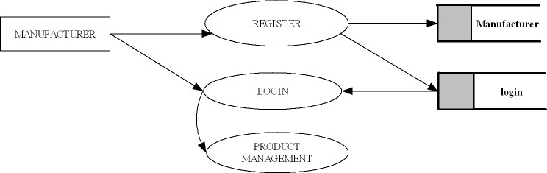
Level 1

Slide 21
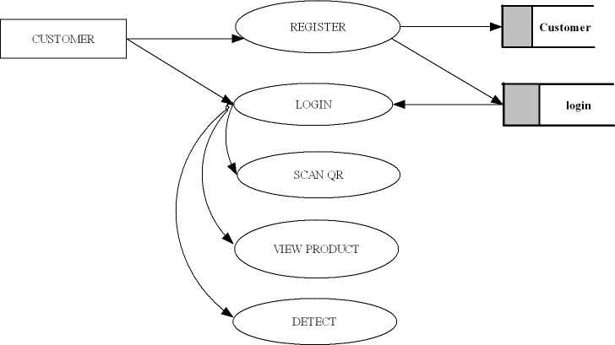
Level 2

Slide 22
GANTT CHART
FEBRUARY
MARCH
APRIL
MAY
Topic Discussion
Feb 14 – Mar 4
Project Study
Mar 5 – Mar 10
Data Collection
Mar 11 – Mar 14
Coding
Mar 15–Apr 20
Testing
Mar 24–Apr 30
UI Design and integration
Apr 24 – Apr 30
Deployment
May 1 – May 6

Slide 23
THANK YOU

